Slide 1
Database Replication
Reference: https://www.youtube.com/watch?v=jLEp1XI_L6Q&t=23s

Slide 2
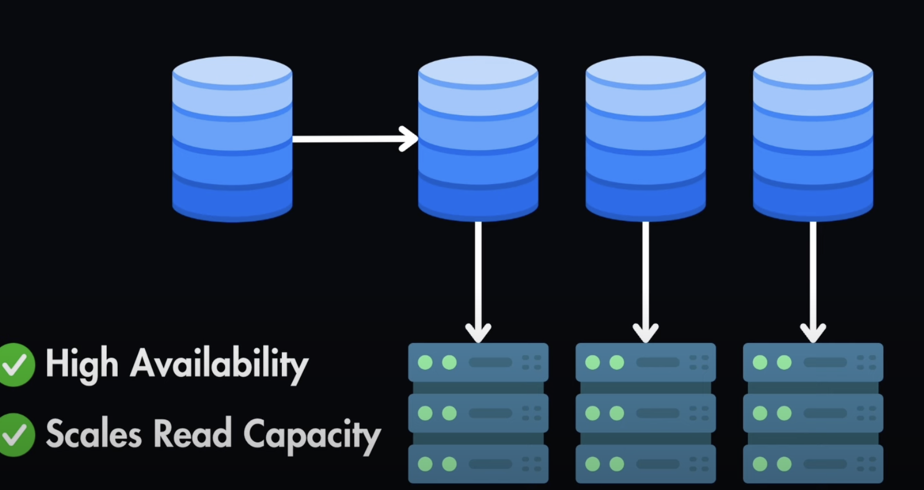
Database Replication is used to guarantee data AVAILABILITY => ensure the system remain responsive in case of high load or DB failures.
DB replication consists in creating multiple copies (called “REPLICAS”) of the same DB running on different servers (and machines).
Pros:
It guarantee High Availability because if one replica goes down, the system can switch to another replica providing uninterrupted services to clients.
It scales read capacity because now we have multiple databases where you can read data from

Slide 3
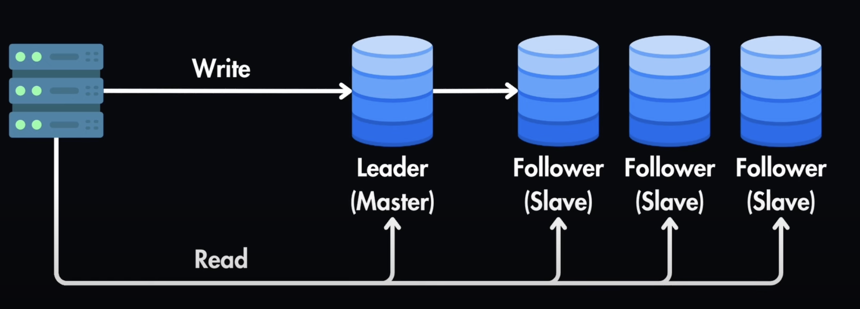
Leader-Follower Replication
Write operations are done only towards the Leader => it’s then the Leader responsible to propagate the changes to the followers
Read operations are spread across both Leader and Followers

Slide 4
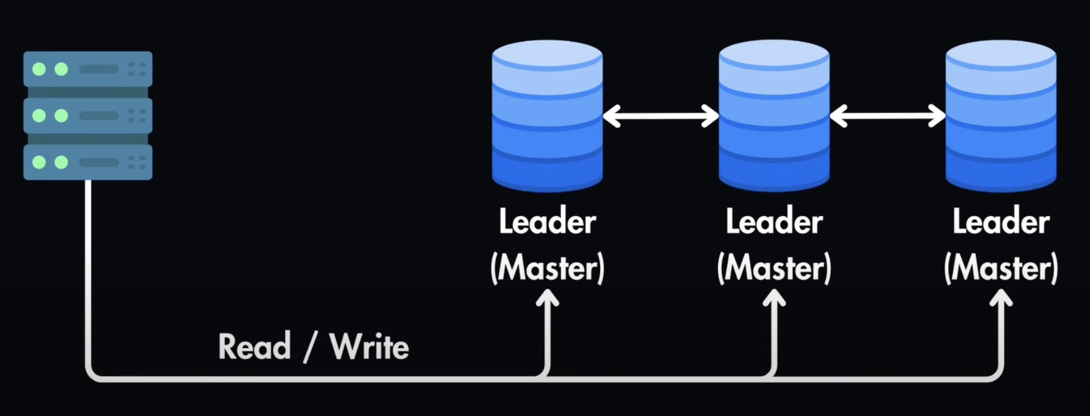
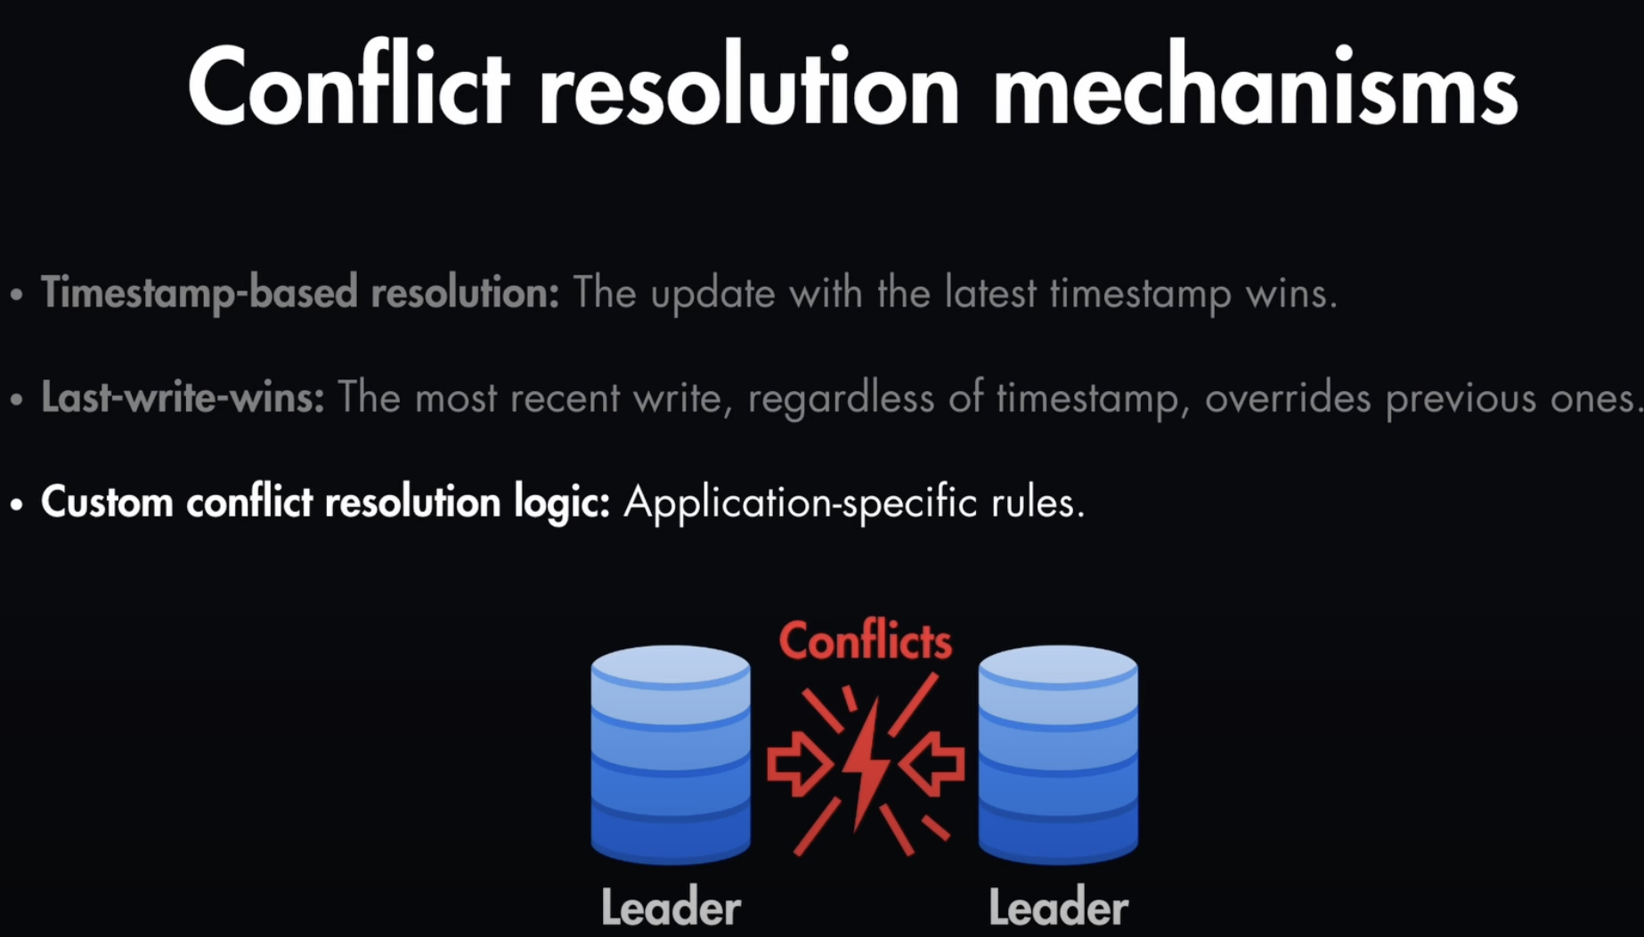
NB: Conflicts on Replication and “Conflicts” on clients writing the same row when using a Single-master with optimistic locking, are two DIFFERENT things => You have to handle application-level conflicts => Even with one primary, multiple app instances can read-then-write the same row concurrently. This isn't a replication conflict but a concurrency conflict — handled with versioning or SELECT FOR UPDATE.
Leader-Leader Replication
Write and Read operations are can be done towards any of the replicas.
A Problem specifically for this approach (which is not in the master-slave approach):
There might be conflicts when writing two clients write to the same record on different nodes simultaneously (for example a user update a record in DB1, while another user update the same record in DB2) => we need to handle conflict resolution mechanisms => There are several options ==>

Slide 5
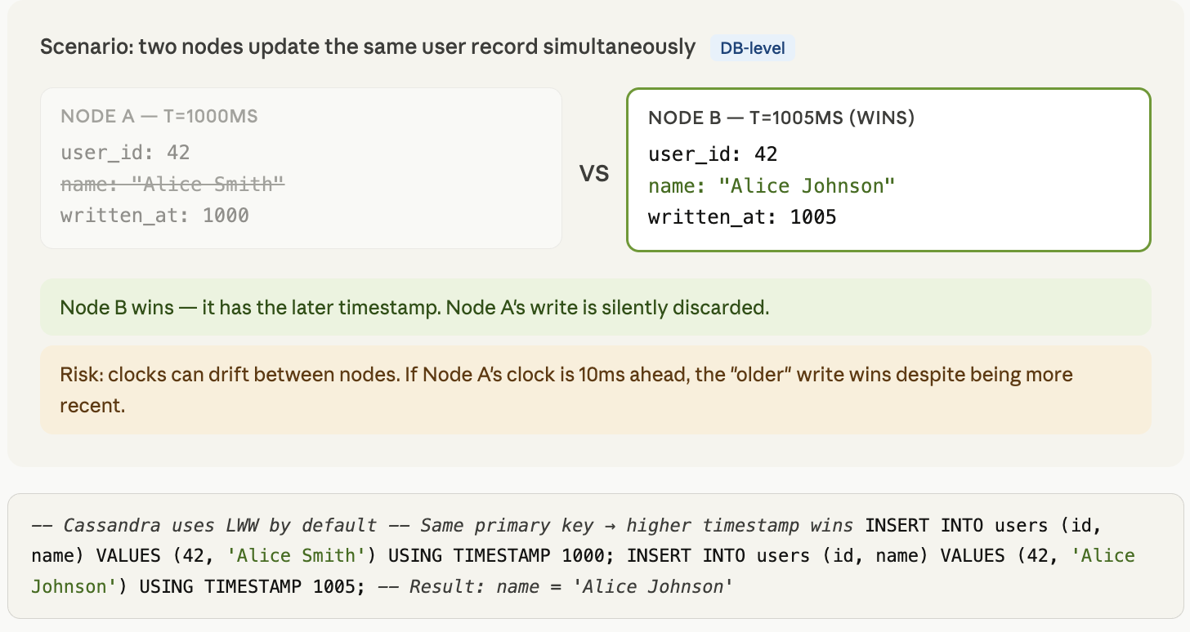
Conflict Resolution Strategies (node Master vs node Master) during Replication
1. Last Write Wins (LWW) The write with the latest timestamp survives. Simple to implement, but clocks across nodes are never perfectly in sync (clock skew), so the "latest" timestamp can be wrong. Cassandra uses this by default.
Risk: silently discards writes. Good for low-stakes data (cache, metrics), bad for financial data.

Slide 6
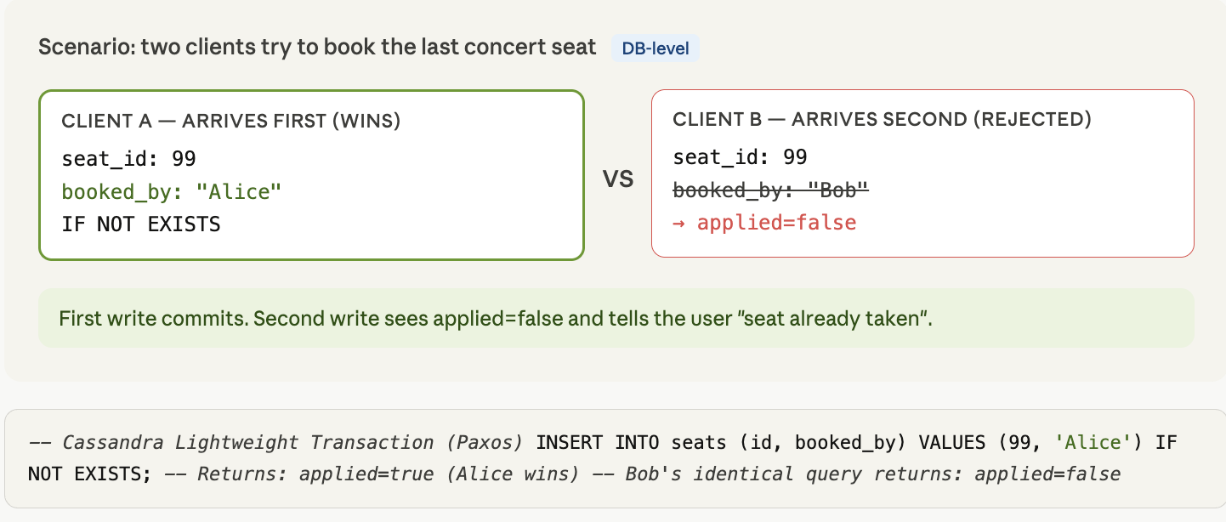
Conflict Resolution Strategies (node Master vs node Master) during Replication
2. First Write Wins The first write to reach consensus wins, subsequent conflicting writes are rejected. Used in some strongly consistent systems.

Slide 7
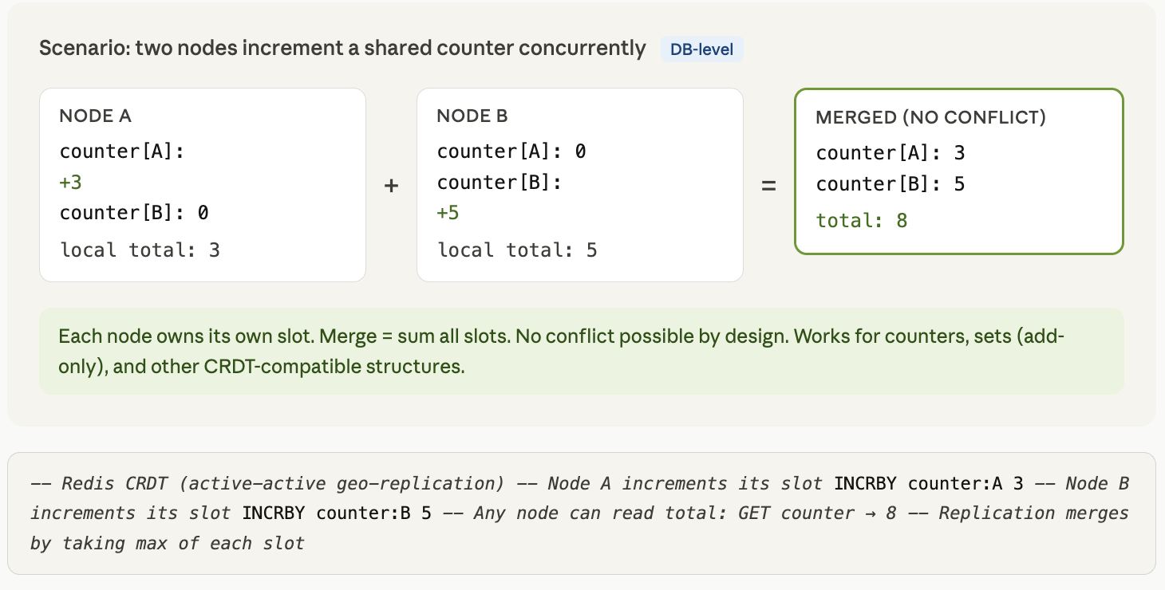
Conflict Resolution Strategies (node Master vs node Master) during Replication
3. Merge / CRDT (Conflict-free Replicated Data Types) Data structures mathematically designed so that any two versions can always be merged without conflict. Common examples: counters, sets with add-only semantics. Used in Redis (some data types), Riak, and eventually-consistent systems. Works well for specific data shapes but can't be applied universally.

Slide 8
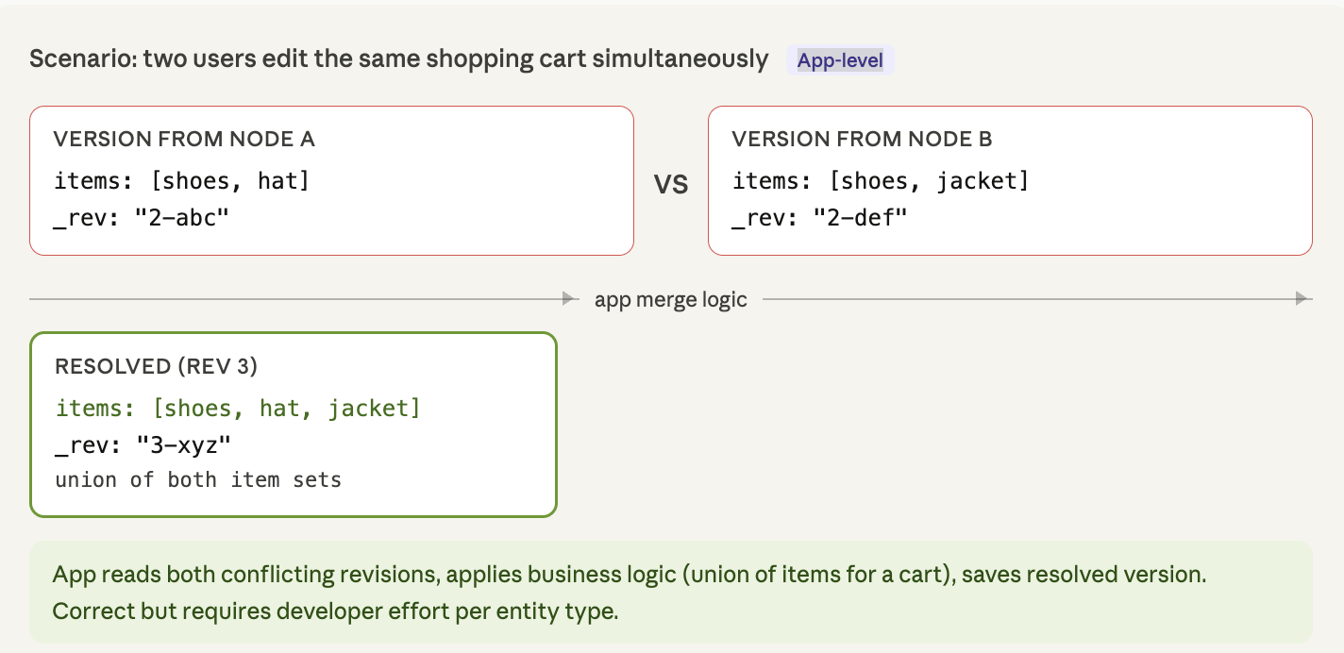
Conflict Resolution Strategies (node Master vs node Master) during Replication
4. Application-level resolution The DB surfaces the conflict to the application, which applies business logic to resolve it. CouchDB does this — it stores all conflicting revisions and asks an external app/code to pick a winner. Most correct approach for complex data, but puts burden on the developer.
“Application-level” resolution, can be done both to handle conflicts on replication or conflicts on clients writing data in a single DB.
In IAM we use a Jenkins job that is triggered every day that reads if there are conflicts and solve them based on a logic (which can be: merge data, take the latest data, etc.).

Slide 9
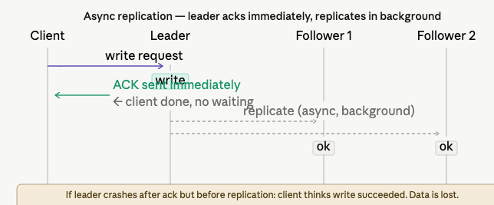
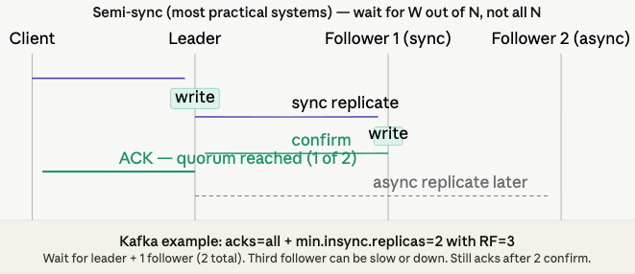
Replication can be both Synchronous or Asynchronous
Sync Replication == QUORUM
Pros:
Changes are committed to both Leaders and Followers before returning back to the client’s request
Guarantee consistency of the data
Con:
Slower than Async => impact the writes performance
Async Replication
Pros:
Sync is done in background
Faster than Sync replication
Con:
Temporarily Data inconsistency
NB^
Sync means => the change is immediately applied by the node in the DB and saved in the Disk! The master can contact or ALL the replicas or just the number of nodes to reach the quorum => depends on how you setup the replication.

Slide 10
Read-Write Quorum (this is not the same as REPLICATION!) => this is mainly related to DURABILITY of DATA
Suppose you have a replication mechanism with 1 Leader and 2 Followers.
According to the read/write quorum, we need to guarantee:
W + R > N
Where:
W = the number of replicas where you write content before declaring a successful write operation
R = the number of replicas from where you read content before declaring a successful read operation
N = the total number of servers (in this case N = 3)
In a read heavy system you could decide that you want to to read from 2 servers only for a successful read and write to at least 2 servers to declare a successful write. Indeed, we would have:
2 + 2 > 3
If you add more nodes and have 1 Leader and 4 Followers (i.e. N=5), In a read heavy system you could decide that you want to to read from 2 servers only for a successful read and write to at least 4 servers to declare a successful write. Indeed, we would have:
4 + 2 > 5

Slide 11
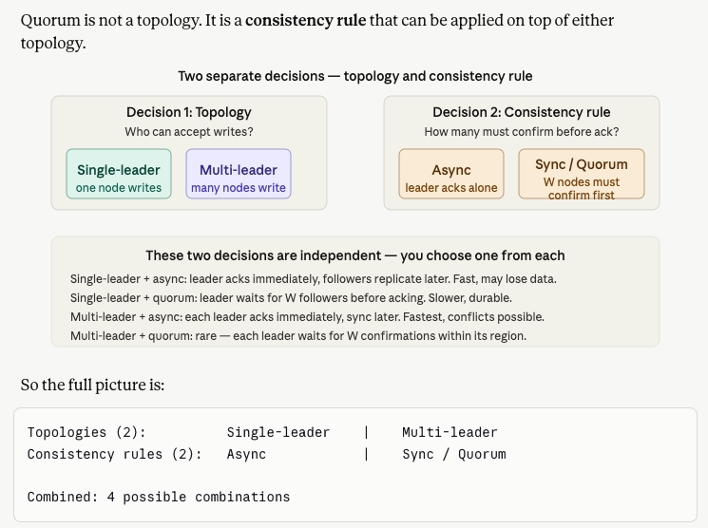
2 replication topologies (master-slaves & master-master) + 2 consistency rules

Slide 12
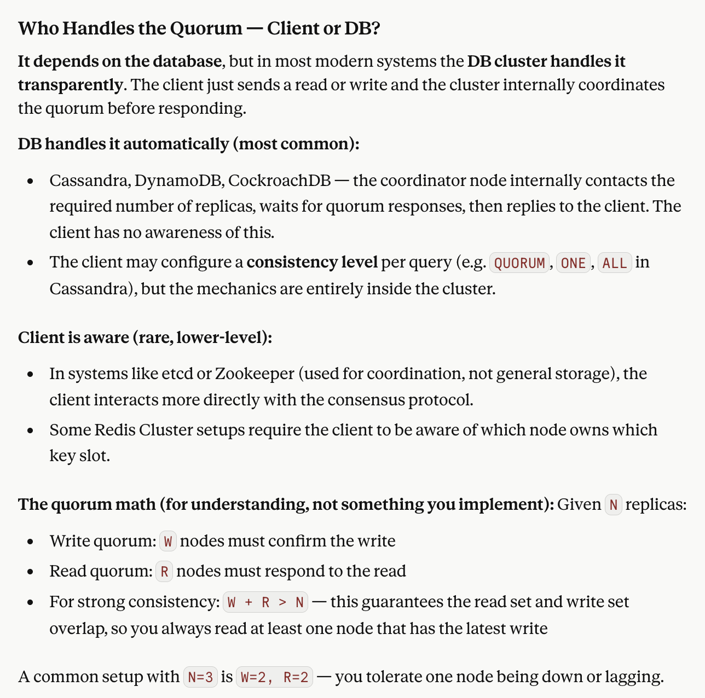
Read-Write Quorum
Who handle it?
Client or DB?

Slide 13
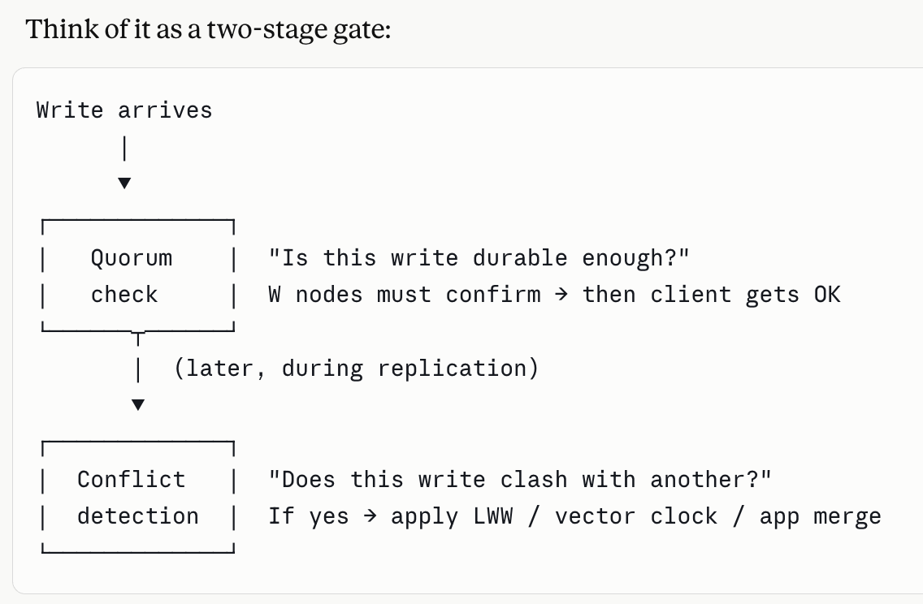
From Read-Write Quorum => To Replication
Quorum operates synchronously at write time.
Replication is done after reaching the quorum and can be synchronous or asynchronous.
A write can pass the quorum gate and still produce a conflict later — these are independent concerns layered on top of each other.

Slide 14
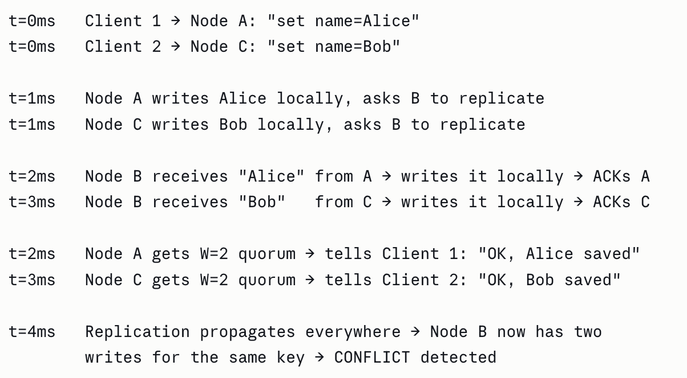
From Read-Write Quorum => To Replication
Example:
When Node B "confirms" a write for quorum purposes, it does two things atomically:
- Writes the value to its local storage
- Sends an acknowledgement back to the coordinator
There is no distributed lock involved. Node B just writes locally and says "done". It has no awareness that another write for the same key might be in flight on Node C at the same moment.
Node B confirmed both writes independently and without coordination. It simply wrote each value as it arrived. No lock, no check against the other in-flight write.
It does not matter if we use sync or async replication + quorum. In both cases there can be conflicts!
If you apply quorum and sync => the data are immediately written in the Disk of the “W” nodes.
if you apply quorum and async => the data are queued and later stored in the Disk of “W” nodes.
But there is still no global checkpoint that said "is anyone else writing this key right now?" => i.e. both masters independently decided to accept the write before any coordination happened.

Slide 15
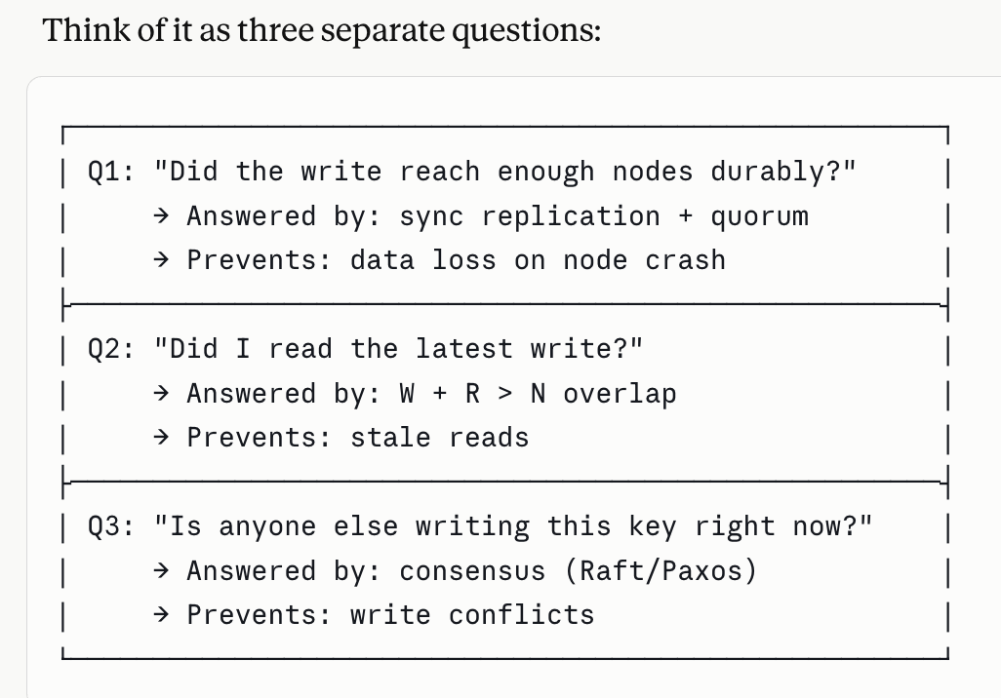
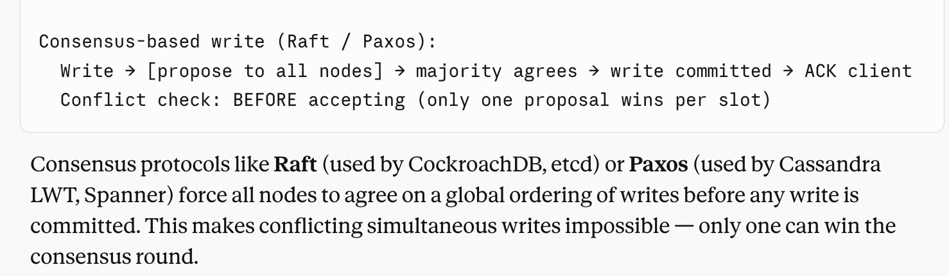
Read-Write Quorum + Replication
Replication + quorum answers Q1 and Q2 very well. But Q3 — the conflict question — requires a completely different mechanism. No amount of tuning W and R resolves this, because the race condition happens before W and R are even consulted.
Replication + Quorum avoid DATA LOST in case the node performing the write goes down and prevent STALE READS.
Example: -- Cassandra Lightweight Transactio:
(Paxos) INSERT INTO seats (id, booked_by) VALUES (99, 'Alice') IF NOT EXISTS;
-- Returns: applied=true (Alice wins) -- Bob's identical query returns: applied=false

